Slide 1

Image Caption Generator
Supervisor – prof. arif ahmed sekh

Slide 2
What is Image Caption Generator?
Image caption generator is a task that involves computer vision and natural language processing concepts to recognize the context of an image and describe them in a natural language like English.

Slide 3
About the Python based Project
The objective of our project is to learn the concepts of a CNN and LSTM model and build a working model of Image caption generator by implementing CNN with LSTM.
In this Python project, we will be implementing the caption generator using CNN (Convolutional Neural Networks) and LSTM (Long short term memory). The image features will be extracted from Xception which is a CNN model trained on the imagenet dataset and then we feed the features into the LSTM model which will be responsible for generating the image captions.
For the image caption generator, we will be using the Flickr_8K dataset. There are also other big datasets like Flickr_30K and MSCOCO dataset but it can take weeks just to train the network so we will be using a small Flickr8k dataset.

Slide 4
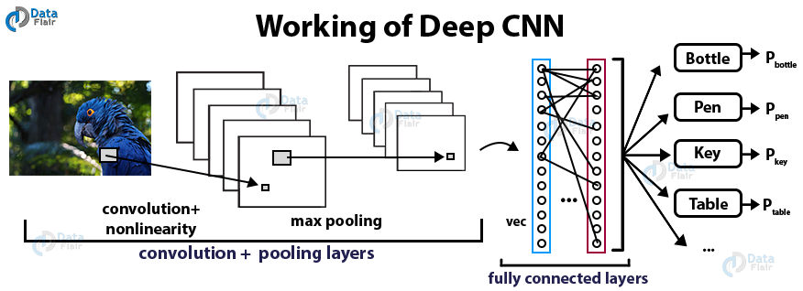
What is CNN ?
Convolutional Neural networks are specialized deep neural networks which can process the data that has input shape like a 2D matrix. Images are easily represented as a 2D matrix and CNN is very useful in working with images. CNN is basically used for image classifications and identifying if an image is a bird, a plane or Superman, etc. It scans images from left to right and top to bottom to pull out important features from the image and combines the feature to classify images. It can handle the images that have been translated, rotated, scaled and changes in perspective.

Slide 5
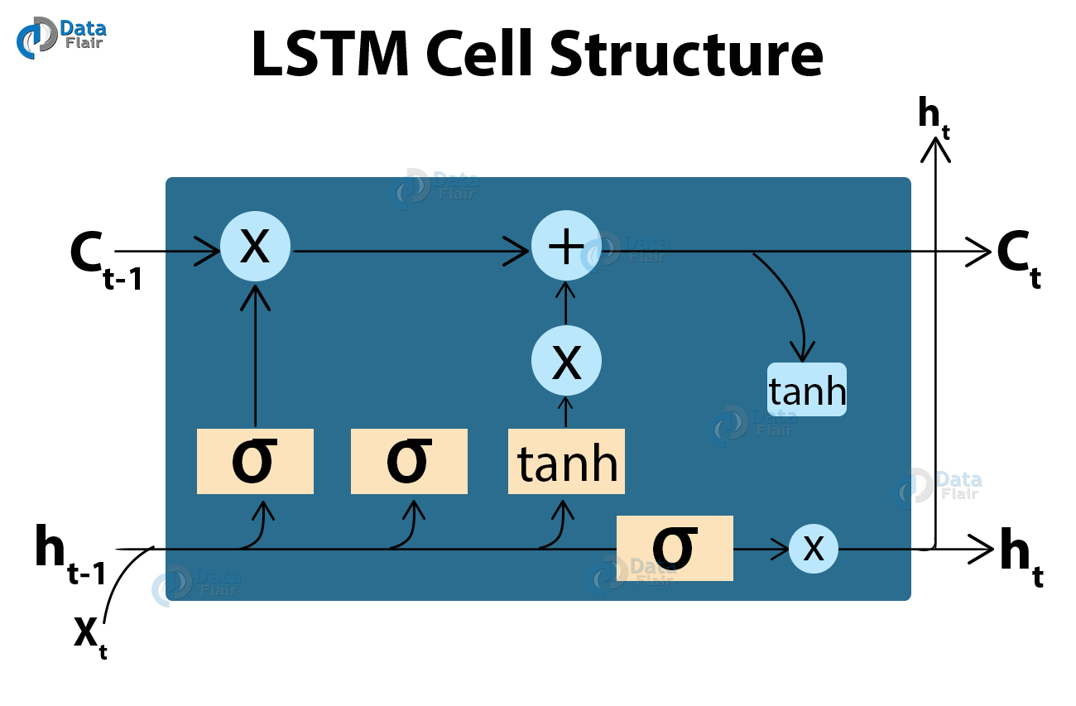
What is LSTM?
LSTM stands for Long short term memory, they are a type of RNN (recurrent neural network) which is well suited for sequence prediction problems. Based on the previous text, we can predict what the next word will be. It has proven itself effective from the traditional RNN by overcoming the limitations of RNN which had short term memory. LSTM can carry out relevant information throughout the processing of inputs and with a forget gate, it discards non-relevant information.

Slide 6
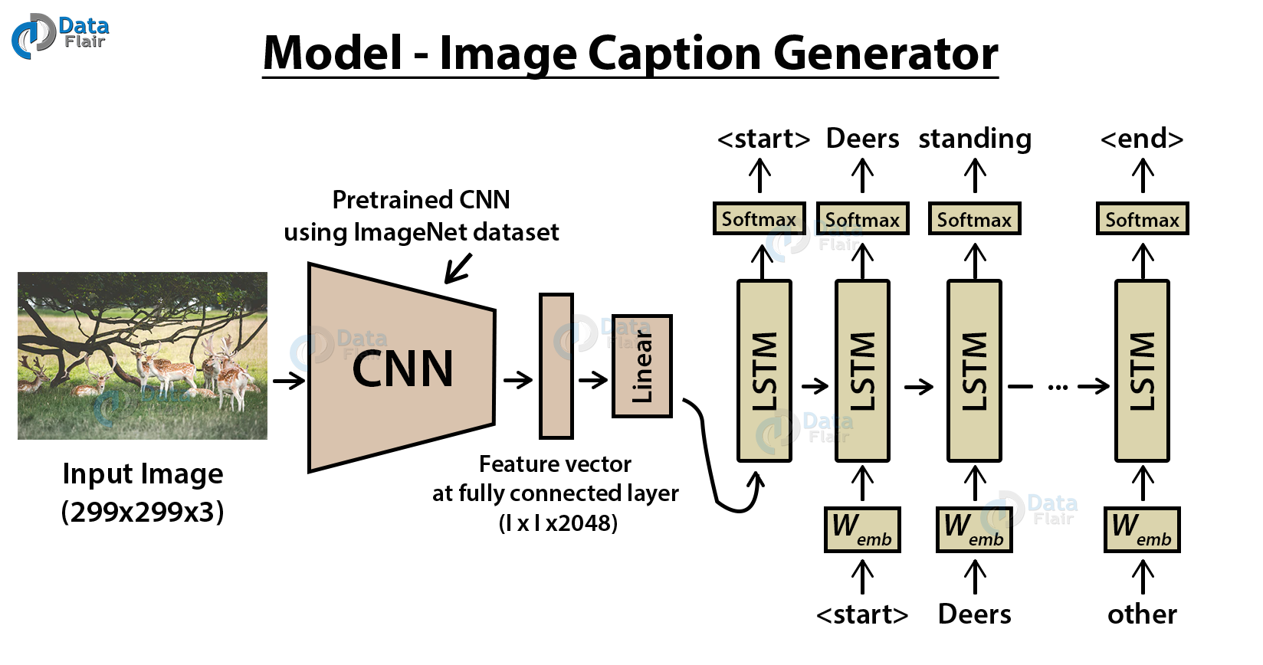
Image Caption Generator Model
So, to make our image caption generator model, we will be merging these architectures. It is also called a CNN-RNN model.
CNN is used for extracting features from the image. We will use the pre-trained model Xception.
LSTM will use the information from CNN to help generate a description of the image.

Slide 7
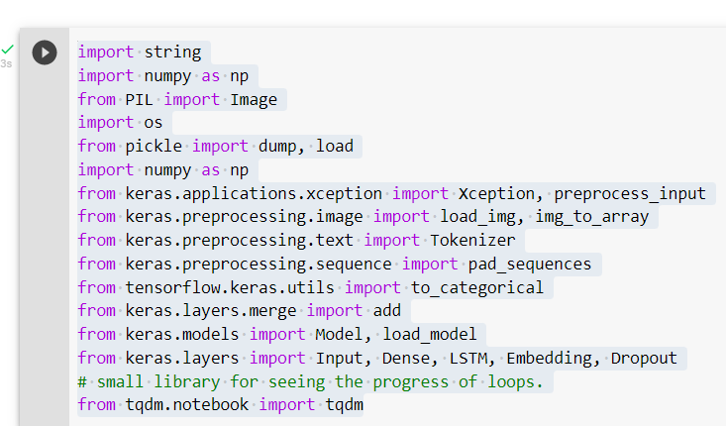
First, we import all the necessary packages

Slide 8
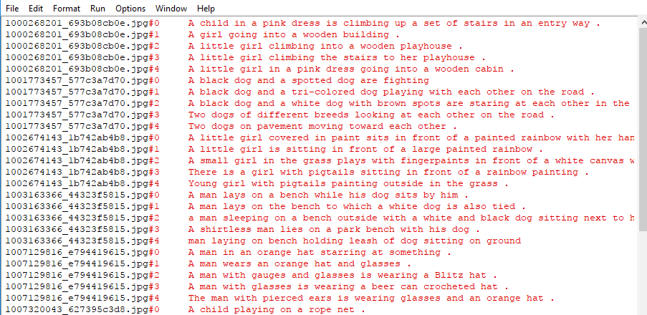
Exploring Flickr_8k_text
The main text file which contains all image captions is Flickr8k.token in our Flickr_8k_text folder. Each image has 5 captions.

Slide 9
Getting and performing data cleaning
load_doc( filename ) – For loading the document file and reading the contents inside the file into a string.
all_img_captions( filename ) – This function will create a descriptions dictionary that maps images with a list of 5 captions.
cleaning_text( descriptions) – This function takes all descriptions and performs data cleaning. This is an important step when we work with textual data, according to our goal, we decide what type of cleaning we want to perform on the text. In our case, we will be removing punctuations, converting all text to lowercase and removing words that contain numbers.
So, a caption like “A man riding on a three-wheeled wheelchair” will be transformed into “man riding on three wheeled wheelchair”
text_vocabulary( descriptions ) – This is a simple function that will separate all the unique words and create the vocabulary from all the descriptions.
save_descriptions( descriptions, filename ) – This function will create a list of all the descriptions that have been preprocessed and store them into a file. We will create a descriptions.txt file to store all the captions.

Slide 10
Extracting the feature vector from all images
This technique is also called transfer learning, we don’t have to do everything on our own, we use the pre-trained model that have been already trained on large datasets and extract the features from these models and use them for our tasks. We are using the Xception model which has been trained on imagenet dataset that had 1000 different classes to classify. We can directly import this model from the keras.applications . Make sure you are connected to the internet as the weights get automatically downloaded. Since the Xception model was originally built for imagenet, we will do little changes for integrating with our model. One thing to notice is that the Xception model takes 299*299*3 image size as input. We will remove the last classification layer and get the 2048 feature vector.
model = Xception( include_top=False, pooling=’avg’ )
The function extract_features() will extract features for all images and we will map image names with their respective feature array. Then we will dump the features dictionary into a “features.p” pickle file.

Slide 11
Loading dataset for Training the model
In our Flickr_8k_test folder, we have Flickr_8k.trainImages.txt file that contains a list of 6000 image names that we will use for training.
For loading the training dataset, we need more functions:
load_photos( filename ) – This will load the text file in a string and will return the list of image names.
load_clean_descriptions( filename, photos ) – This function will create a dictionary that contains captions for each photo from the list of photos. We also append the <start> and <end> identifier for each caption. We need this so that our LSTM model can identify the starting and ending of the caption.
load_features(photos) – This function will give us the dictionary for image names and their feature vector which we have previously extracted from the Xception model.

Slide 12
Tokenizing the vocabulary
Computers don’t understand English words, for computers, we will have to represent them with numbers. So, we will map each word of the vocabulary with a unique index value. Keras library provides us with the tokenizer function that we will use to create tokens from our vocabulary and save them to a “tokenizer.p” pickle file.
Our vocabulary contains 7577 words.
We calculate the maximum length of the descriptions. This is important for deciding the model structure parameters. Max_length of description is 32.

Slide 13
Create Data generator
To make this task into a supervised learning task, we have to provide input and output to the model for training. We have to train our model on 6000 images and each image will contain 2048 length feature vector and caption is also represented as numbers. This amount of data for 6000 images is not possible to hold into memory so we will be using a generator method that will yield batches. The generator will yield the input and output sequence.
For example:
The input to our model is [x1, x2] and the output will be y, where x1 is the 2048 feature vector of that image, x2 is the input text sequence and y is the output text sequence that the model has to predict.
x1(feature vector) | x2(Text sequence) | y(word to predict)
feature | start, | two
feature | start, two | dogs
feature | start, two, dogs | drink
feature | start, two, dogs, drink | water
feature | start, two, dogs, drink, water | end

Slide 14
Defining the CNN-RNN model
To define the structure of the model, we will be using the Keras Model from Functional API. It will consist of three major parts:
Feature Extractor – The feature extracted from the image has a size of 2048, with a dense layer, we will reduce the dimensions to 256 nodes.
Sequence Processor – An embedding layer will handle the textual input, followed by the LSTM layer.
Decoder – By merging the output from the above two layers, we will process by the dense layer to make the final prediction. The final layer will contain the number of nodes equal to our vocabulary size.

Slide 15
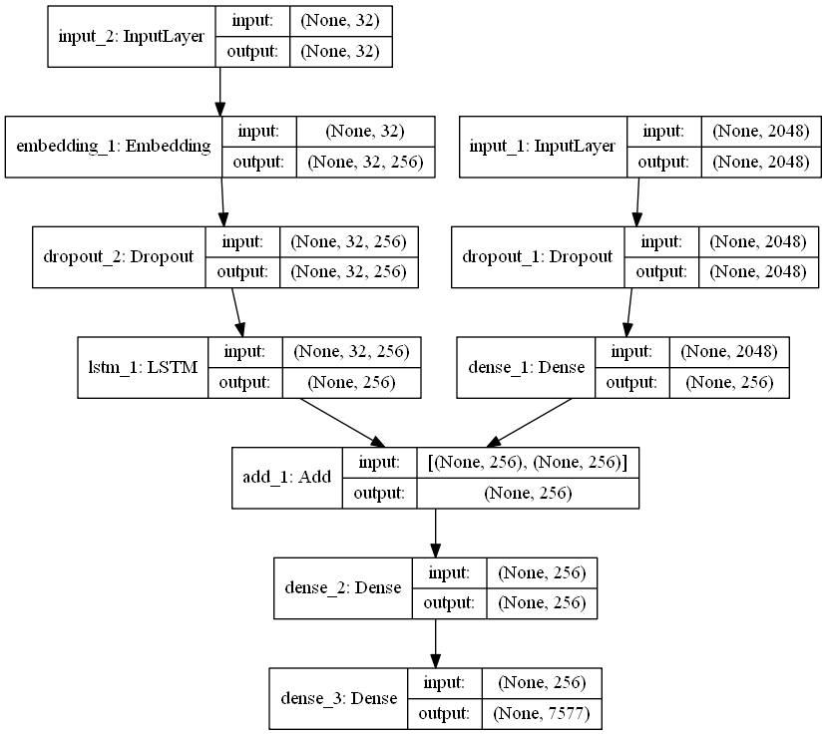
Visual representation of the final model

Slide 16
Training & Testing the model
To train the model, we will be using the 6000 training images by generating the input and output sequences in batches and fitting them to the model using model.fit_generator() method. We also save the model to our models folder.
After training the model we will make a separate file testing_caption_generator.py which will load the model and generate predictions. The predictions contain the max length of index values so we will use the same tokenizer.p pickle file to get the words from their index values.

Slide 17
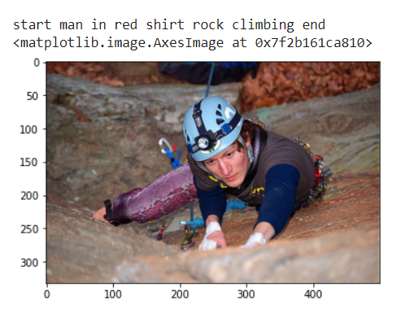
Results

Slide 18
References
https://data-flair.training/blogs/python-based-project-image-caption-generator-cnn/
https://www.researchgate.net/publication/333651453_Detection_and_Recognition_of_Objects_in_Image_Caption_Generator_System_A_Deep_Learning_Approach
https://ieeexplore.ieee.org/document/8728516
https://blog.clairvoyantsoft.com/image-caption-generator-535b8e9a66ac
https://medium.com/@raman.shinde15/image-captioning-with-flickr8k-dataset-bleu-4bcba0b52926
https://www.geeksforgeeks.org/image-caption-generator-using-deep-learning-on-flickr8k-dataset/

Slide 19
Thank you
Harihar panda

